Slide 1
Internet of things
Filip Michalek

Slide 2
What is internet of things (iot)
IoT – is a system of devices connected to the Internet with the ability to collect and exchange data from users or environment with no human invention.
Big data
Could be any device with electronics, software and sensor.
Automate everything
Control everything remotely
See data in real-time

Slide 3
Why to use iot
Organizations in a variety of industries are using IoT to operate more efficiently, better understand customers to deliver enhanced customer service, improve decision-making and increase the value of the business.

Slide 4
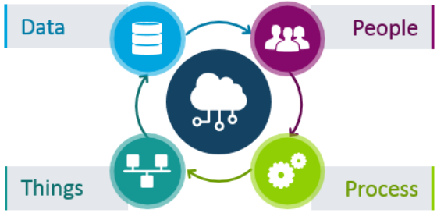
Iot ecosystem
An IoT ecosystem consists of web-enabled smart devices that use embedded processors, sensors and communication hardware to collect, send and act on data they acquire from their environments.
IoT devices share the sensor data they collect by connecting to an IoT gateway or other edge device where data is either sent to the cloud to be analyzed or analyzed locally.

Slide 5
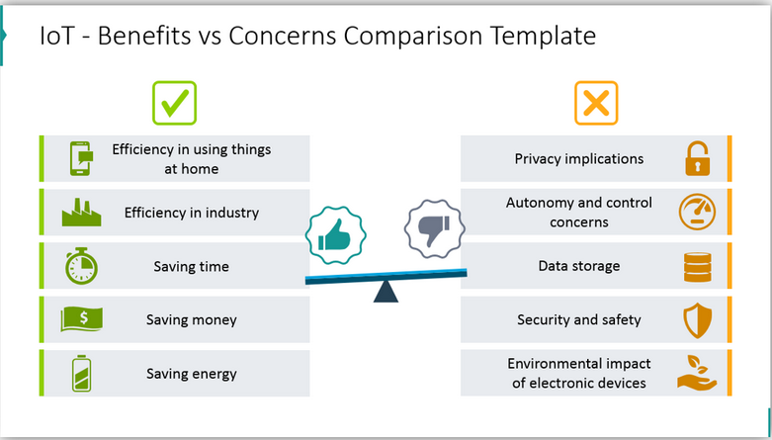
Pros and cons of iot

Slide 6
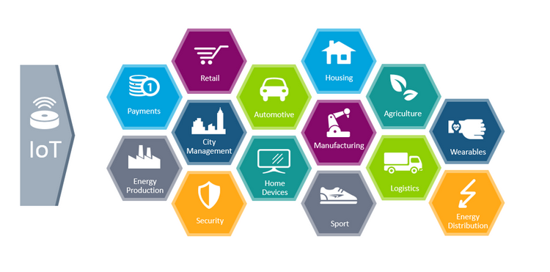
Industries that already use iot

Slide 7
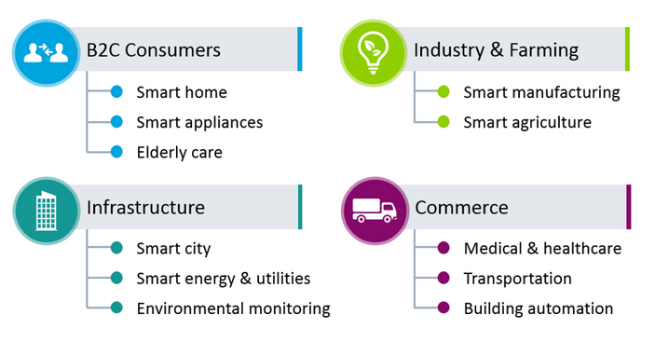
applications

Slide 8
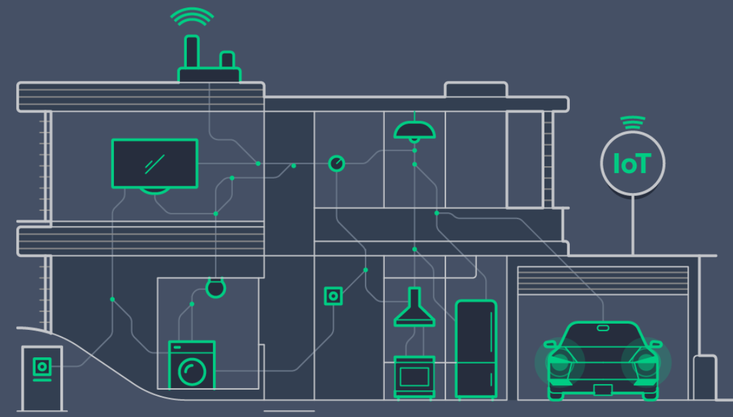
Smart home
Lighting
Doors
Windows
Thermostat
Gardens
Home routines
Household appliances

Slide 9
Thank you for your attention
"Anything that can be connected, will be connected"

